Slide 1
CAN ECONOMICS INTERPRET ECONOMIC HISTORY? AND, IS IT USEFUL?
From necessities to imaginary worlds: structural change, product quality and economic development
Pier Paolo Saviotti* ° & Andres Pyka°
*ECIS (Eindhoven Technological University),
*INRA GAEL, GREDEG CNRS, Department of Economics, Hohenheim University
° Department of Economics, Hohenheim University

Slide 2
Structural change and long run economic development
Long run
Innovation
Need for economic models to be able to explain long run patterns (Possible? Desirable? Useful?)
Structural change
Change in the structure and composition of the economic system
Long run development impossible without structural change (emergence of new sectors, institutions, organizations etc)
Innovation gives rise to qualitative change, structural change and uncertainty
Structural change difficult to detect in the short run; relatively slow process)

Slide 3
Development trajectories (laws?)
Trajectory 1: The efficiency of productive processes increases during the course of economic development.
Efficiency = the ratio of the inputs used to the output produced, when the type of output remains constant.
Trajectory 2: The output variety of the economic system increases in the course of time.
Here such variety is measured by the number of distinguishable sectors
A sector is defined as the set of firms producing a common although highly differentiated output
Trajectory 3: The output quality and internal differentiation of existing sectors increases in the course of time after their creation.
This means that if during the period of observation the type of output changes what we will observe is a combination of growing productive efficiency and of quality change
Arrow of time
ISI : add manufacturing to Natural Resources = differentiation
Notes:
Trajectory 1 is affected by division of labour 1 (separation of a given process with a constant output into a greater number of steps) which increases productive efficiency. Trajectories 2 and 3 are directly affected by division of labour 2 ( increase in the number of possible processes and of corresponding competencies. See The Wealth of Nations pp.xx. But trajectories 2 and 3 cannot exist without trajectory 1.

Slide 4
Trajectories not independent
Continuous increase in productive efficiency + saturating demand → bottleneck
All demanded output could have been produced by a declining proportion of the labor force (Pasinetti, 1981)
but
Emergence of new sectors & their internal differentiation and rising quality
Can ‘re-employ’ the labour force potentially displaced by efficiency alone, compensate the bottleneck and allow long term continuation of development
Differences vs Pasinetti
no saturation but slowing down of the rate of growth of demand with income
neglect of quality and differentiation
greater possible plurality of development paths
Efficiency and Variety/quality complementary

Slide 5
Differentiation and economic development
Need for increasing differentiation of the economic system
For all countries? Or distribution of strategies?
Romer growing output variety,
Output variety vs product quality
Export variety as a catch up strategy
Natural resources based strategy
Aghion Howitt growing product quality but constant output variety
Necessary condition to allow the long run continuation of economic development. Compensation for Pasinetti (Marx) trap
Quality based vs variety based strategies

Slide 6
TEVECON
Economic system composed of an endogenously variable number of sectors
Emergence of new sectors induced by the saturation of pre-existing ones
Sector created by important/pervasive, innovation
entrepreneurs start new companies →new industry→ bandwagon imitators → increasing intensity of competition → saturation
Adjustment gap AG_{i}, (Initially size of potential market, distance from saturation)
AG_{i} very large right after the creation of the sector, then decreases gradually, although not continuously

Slide 7
TEVECON (2)
Demand
Search activities
Depends on price, product quality, product differentiation, disposable income and preferences
activities improving our understanding of ExtEnv → new routines
Competition
Both intra and inter sector

Slide 8
TEVECON (3)
Dynamics and competition
Emergence of new sectors
Sector dynamics: entry (Entrepreneurs + bandwagon of imitators) and exit (failure + M&A) of firms
Competition: from temporary monopoly to bandwagon of imitators (rising intensity of competition) to the circular flow
Competition: both inter- and intra-sector
entry
Entrepreneurs
Temporary monopoly
Saturation
failure
M&A
Inducement new sector
Creation of new niche if technology available
development
bandwagon of imitators
Increasing ICi
Notes:
Schumpeterian entrepreneurs create new firms to exploit a pervasive innovation induced by the expectation of a temporary monopoly. The following bandwagon of imitators raises the intensity of competition and gradually eliminates any further inducement to enter. Thus, the once innovative sector is transformed into a part of the circular flow (Schumpeter, 1912) or into one additional routine of the economic system.

Slide 9
Entry, exit and number of firms
Industry life cycles in most but not in all in circumstances

Slide 10
Employment
Aggregate employment can grow even when the rate of growth of employment within each sector is negative (compensation)

Slide 11
Periods in capitalist development
Necessities → imaginary words
low quality (LQ) → high quality (HQ)
Notes:
Two types of wants: necessities are given by our biological heritage, imaginary worlds defines tyeps of wants which are not necessary for survival but which have a socially induced/constructed importance in advanced societies.

Slide 12
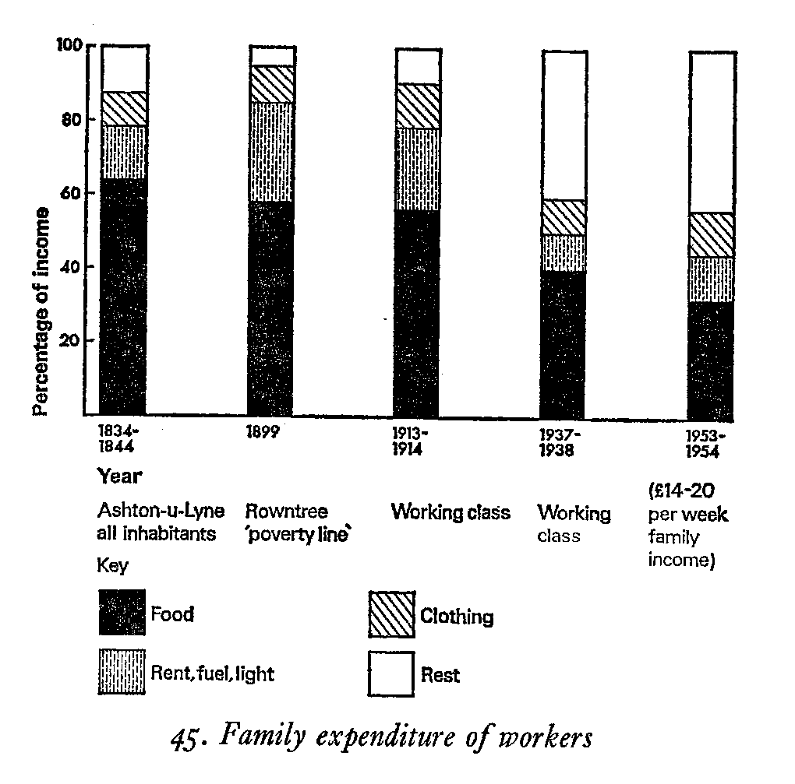
Demand evolution
Since the industrial revolution from necessities to imaginary worlds

Slide 13
Co-evolution of innovation and demand
No contribution of innovation to economic development unless
a demand for the goods and services created by innovation existed
Simple relative of systemic approach
Co-evolution as a general mechanism of economic development
Required: (i) disposable income (ii) preferences
Provides rapid acceleration of entry of new sectors activities

Slide 14
Population and education
Education
Population
Grew very fast during the XIXth century starting from the beginning of the industrial revolution
The rate of growth of population fell drastically as countries became very rich
The fall in the rate of growth of population coincided with a growing intensity of education

Slide 15
Human capital and education
Human capital
Investment in education→ education capital stock (CS_{edi}) → quality h_{i} of human capital
k_{ed} = the quality of educational institutions in forming human capital
Overall human capital H_{i} is obtained by multiplying sectoral labour by the quality h_{i} of human capital

Slide 16
Variety, product quality, income and employment growth
Income growth
Employment growth
LQ : light curve, HQ: bold curve Vertical line : time required for HQ income to catch up with and to overtake LQ ( ICUT)
LQ light curve, HQ bold curve

Slide 17
Comparison LQ, HQ
Faster rate of employment growth
Rate of income growth initially faster but later falling behind
HQ
Slower rate of employment growth
LQ
Rate of income growth initially lower but later overtaking
Lower & constant wages, quality of human capital and sectoral demand
Growing wages, quality of human capital and sectoral demand

Slide 18
Transition LQ → HQ
The observed economic development path
resembles a combination of LQ first and HQ later
is not explained only by the relative rates of population growth but also by the transition LQ →HQ
Economic development seems to have been driven more by
income growth than by
employment growth

Slide 19
Mechanism of economic development
(LQ → HQ) transition can occur through a virtuous circle, but not under all circumstances. See for example effect of k_{qual}
Wages as costs vs purchasing power
Falling rate of population growth
Increasing Quality & Diff
Increasing Competencies
Higher product price
Higher wages
Disposable income, demand
Increasing education

Slide 20
Mechanism of economic development beyond necessities
Disp_{i}
In,ca
Empl
In_{i}
Di
h_{i}
Q_{i}
Ed_{i}
Pop
SE_{i}
Y_{i}

Slide 21
Summary and conclusions
Differentiation necessary but can be achieved by
a)Growing Variety (arrow of time)
b) Growing quality and internal differentiation
Different possible combinations of a) and b)
Different development paths
Different NIS
Co-evolution of innovation and demand
Requires disposable income and adequate preferences
Can be created by growing productive efficiency in incumbent sectors + employment income in new sectors

Slide 22
Summary and conclusions (2)
Population
During the XIXth century growing wealth was used to feed a growing population
No increase in income per capita
LQ→ HQ transition
Income initially higher for LQ later for HQ (transition LQ → HQ)
Population not only determinant of static income
Education
Growing education, required by growing output quality, later contributed to slow down the rate of growth of Population
And to raise wages
Increasing education and population growth

Slide 23
Export variety
A very successful strategy of catch-up and economic development
When it can be applied
See Japan ˂1990; Korea (S); Taiwan; Singapore; China; Malaysia
Development path
In the short run better to differentiate towards Related export variety (REXPVAR)
In the long(er) run growing unrelated export variety (UEXPVAR) is required
Variety vs output quality and internal differentiation
Different possible combinations leading to
Different economic development paths and different national innovation systems (NIS)
Keep ratio V_{N}/N_{w} almost constant or growing

Slide 24
Export variety and natural resources
NR based development strategy can lead to the economic frontier but
It may entail the curse of natural resources
It often does not lead country/region towards the technological frontier
Curse may entail
worsening quality of institutions
reduction in social welfare
A virtuous natural resources based development strategy?
Learning
It often reduces export variety
inhibits the differentiation of the economic system
does not require or inhibits learning
Distribution
Education
Related variety

Slide 25
Extensions and policy implications
Implications of structural change for economic policy
Due to structural change the composition of competencies cannot remain constant but
Needs to change to adapt to the labour market and to the international economic environment
Learning economy
Retraining needs to become a regular feature of working lives
Job security is incompatible with employment security
Combination of technological trends and emerging countries
Flexicurity follows
TEVECON good intellectual basis for Flexicurity type policies which cannot be justified by orthodox theories

Slide 26
Labour market and employment policies
Unemployment benefits
Wrong: to pay someone to stay out of the labour market
if the cause of the unemployment is poor adaptation of competencies to the labour market
New Keynesian policies
Need to adapt to structural change
Labour market = people working + people learning
Transfer resources from unemployment benefits towards training
Policy aimed at removing people from jobs where they cannot logically stay by re-training
Flexicurity

Slide 27
Co-evolution, innovation and demand
Closed system
Supply: growing efficiency & surplus of incumbent sectors to fund search activities for innovation in future sectors
Demand: growing efficiency of incumbent sectors → lower costs & prices + income effect of new sectors
Open system
if supply of innovation is missing need for
(non innovation?) exports to keep balance of trade
Distributive policies
Can help to create disposable income but
See (i) balance of trade and (ii) education

Slide 28
Questions
Structural change: trends in technologies and methods of production
Falling labour intesity
Increasing capital intensity
Structural change and economic development
Technological obsolescence
Globalization
How long is the long run?
In the long run we are all dead (Keynes)
Why is it useful to try and explain long run economic development?
Is the long run constant ?

Slide 29

Publications
Saviotti P.P., Pyka A. (2013), From necessities to imaginary worlds: Structural change, product quality and economic development, forthcoming Technological Forecasting & Social Change
Saviotti P.P., Pyka A. (2012), On The Co-Evolution Of Innovation And Demand: Some Policy Implications, Revue de l'OFCE, n°124, pp 349-388 - Debates and policies: Agent-based models and economic policy, edited by Jean-Luc Gaffard and Mauro Napoletano
Saviotti P.P., Pyka A., Generalized barriers to entry and economic development, Journal of Evolutionary Economics, Vol 21 (2010) pp 29-52
Saviotti P.P., Pyka A., Product Variety, Competition and Economic Growth, Journal of Evolutionary Economics, Vol 18 (2008) 323-347
Saviotti P.P. , Frenken K., Export variety and the economic performance of countries, Journal of Evolutionary Economics, Vol 18 (2008) pp. 201-218
Saviotti P.P., Pyka A. , Micro and macro dynamics: Industry life cycles,inter-sector coordination and aggregate growth, Journal of Evolutionary Economics, Vol 18 (2008) pp. 167-182
Saviotti P.P., Pyka A. Economic development, variety and employment, Revue Economique, Vol 55 (6) special issue on Structural change and Growth, (J.L Gaffard, P.P. Saviotti eds), (November 2004)
Saviotti P.P., Pyka A. Economic Development, Qualitative Change And Employment Creation, Structural Change And Economic Dynamics Vol 15 (2004) 265-287.
Saviotti P.P., Pyka A., Economic Development By The Creation Of New Sectors, Journal of Evolutionary Economics, 14, (1) (2004) 1-35.

Slide 30
Publications
Javaid N.M., Saviotti P.P., Financial system and technological catching-up: an empirical analysis, Is there a recipe for increasing the export variety of nations? Journal of Evolutionary Economics, Vol 22 (2012) pp. 847-870
Saviotti P.P. , Frenken K., Export variety and the economic performance of countries, Journal of Evolutionary Economics, Vol 18 (2008) pp. 201-218

Slide 31
Working Papers
Saviotti P.P., Nesta L., Javaid M.N., Export variety and the catching up of Countries, presented at the 8th Globelics International Conference eld on November 1-3, 2010, Kuala Lumpur, Malaysia.

Slide 32
Appendix

Slide 33
Search Activities
Search activities (activities improving our understanding of ExtEnv → new routines) co-evolve with demand

Slide 34
Adjustment gap and competition
Adjustment gap : Distance from saturation (from equilibrium?)
Competition: inter + intra
IC_{i} =intensity of competiton in sector i
k_{ic} = parameter expressing the competitiveness of a particular economic environment
R_{II}= ratio of inter to intra sector competition
N_{i} : number of firms in sector i
Ntot : total number of firms in the economic system

Slide 35
Effects of (low-high) product quality
Effect of product quality on sectoral demand, low (pink) and high (blue) case
Quality of human capital with low (pink) or high (blue) product quality
Output with low (pink) and high (blue) product quality
Wages with low (pink) and high (blue) product quality

Slide 36
Disposable income for new sectors
D_{Disp,i} = total income - the income required to satisfy the types of consumption of previous periods in period t
Due to surplus created by increasing efficiency of incumbent sectors and by investment in new sectors
Disposable income created in the economic system in the course of time

Slide 37
Preferences
Three preference systems:
Progressive preference system: k_{pref, i+1} > k_{pref,i}
Conservative preference system: k_{pref, i+1} < k_{pref,i}
Random preference system: k_{pref, i+1} >< k_{pref,i}
Influence of the different preference systems on the rate of growth of income
Influence of the different preference systems on the rate of growth of employment

Slide 38

Population and education
Effect of initial investment in education on population growth. Initial investment increases from blue to brown to green
Unemployment for various levels of initial investment in education. Initial investment increases from blue to brown to green
Income per head for various levels of initial investment in education

Slide 39
Wages vs growth
Income per head in the HQ scenario for different values of k_{w}. Income per head rises with rising values of k_{w}.

Slide 40
Product quality & education vs growth
Effect of increasing k_{Qual} on income per head. Higher values of k_{Qual} correspond to lighter curves.
Effect of increasing k_{Qual} on the rate of growth of unemployment. Higher values of k_{Qual} correspond to lighter curves.

Slide 41
Creation vs distribution of resources
Capitalist system
Does not create evenly distributed income
No distribution of competencies and income so far
Tension between
(a) resource creation and (b) resource distribution
Competition or complementarity
(a) Requires entrepreneurship environment, (b) requires redistributive policies
Redistributive policies can raise disposable income
And contribute to the creation of resources

